Slide 1

UART

Slide 2

Communication
How does a PC communicate with its processors?

Slide 3
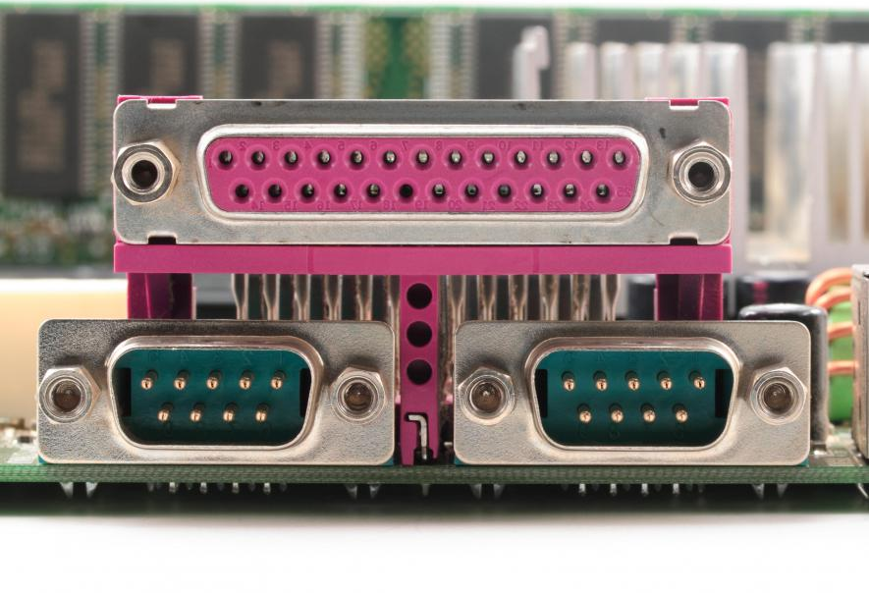
Types of communication
Series
Parallel

Slide 4
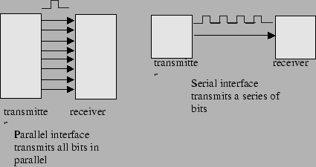
What’s the difference?

Slide 5
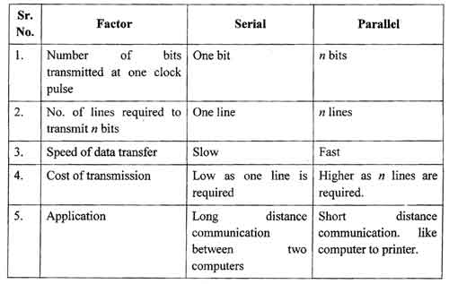

Slide 6
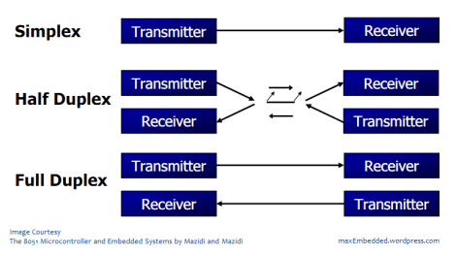
Types of Serial communication

Slide 7
Another Classification
Serial Communication
Asynchronous
Synchronous

Slide 8
Difference?!
Synchronous mode | Asynchronus mode
Requires clock and data | Requires data only
Data transmitted at fixed rate | No fixed rate
Transmitted as blocks | Transmitted as bytes
Allows higher transfer rate | Limits transfer rate

Slide 9
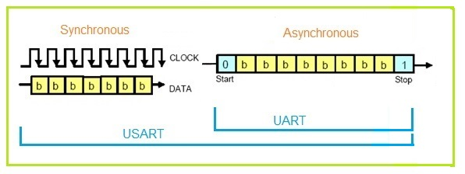
Difference?!

Slide 10
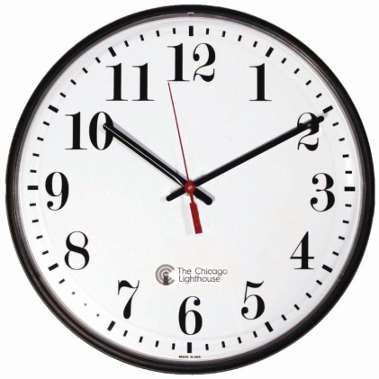
USART
A USART (Universal Synchronous/Asynchronous Receiver/Transmitter) is a microchip that facilitates communication through a computer's serial port using the RS-232C protocol.
Arduino Uno has a USART interface, which can be configured for use in either mode.

Slide 11
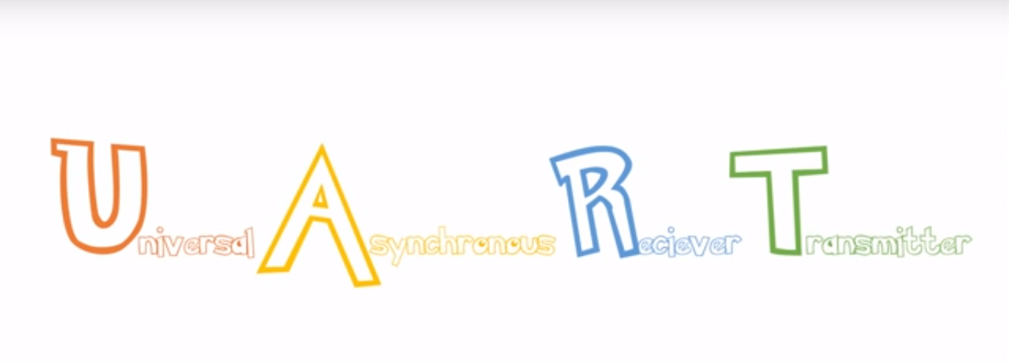
UART

Slide 12
UART is the simplest form of communication between microcontroller and PC. The UART takes bytes of data and transmits the individual bits in a sequential fashion.
In this case, the sender and receiver must agree on timing parameters (Baud Rate) prior transmission and special bits are added to each word to synchronize the sending and receiving units.

Slide 13
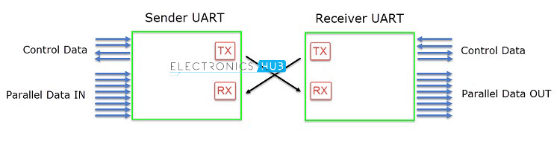
In UART, a start bit and stop bits are used to synchronize the incoming data line.
As there is no "clock" line so for synchronization accurate timing is required so transmissions are carried out with certain standard speeds.
The speeds are measured in bits per second. Number of bits transmitted is also known as baud rate.
Some standard baud rates are 1200, 2400, 4800, 9600, 19200 ... etc.

Slide 14
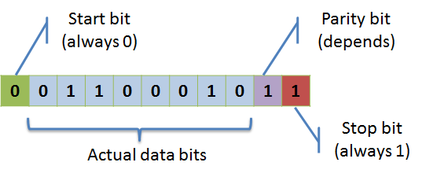
The USART accepts all 30 combinations of the following as valid frame formats:
• 1 start bit (Always low)
• 5, 6, 7, 8, or 9 data bits
• no, even or odd parity bit
• 1 or 2 stop bits (Always high)

Slide 15
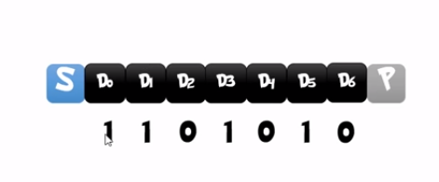
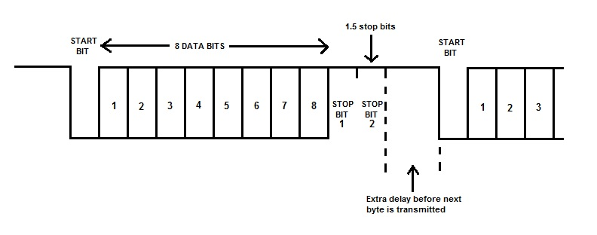
Data transmission in UART

Slide 16
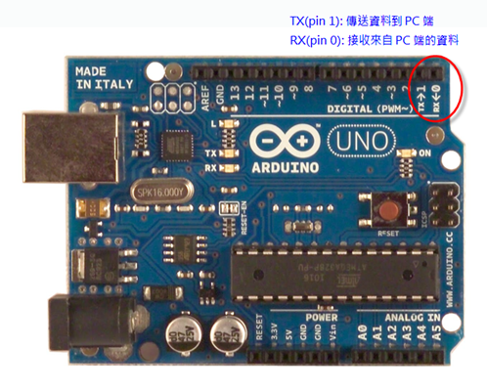
In an Arduino

Slide 17
Registers
UDRn – Data
UCSRnA – Control & Status
USCRnB - Control & Status
UCSRnC – Control & Status
UBRR – Baud Rate

Slide 18

Formula for Baud Rate calculation
Baud = $\frac{{\text{f}}_{\text{OSC}}}{\text{16}\text{∗(}\text{UBRR}\text{n} \text{+ 1}\text{)} }$
UBRRn = $\frac{{\text{f}}_{\text{OSC}}}{16∗Baud}−1$

Slide 19
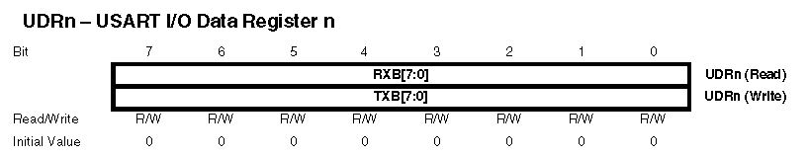
UDRn Contains the data

Slide 20
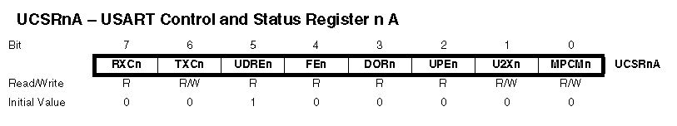
UCSRnA Control and Status Register A

Slide 21
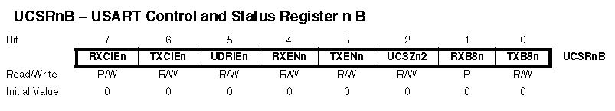
UCSRnB Control and Status Register A

Slide 22

UCSRnC Control and Status Register A

Slide 23
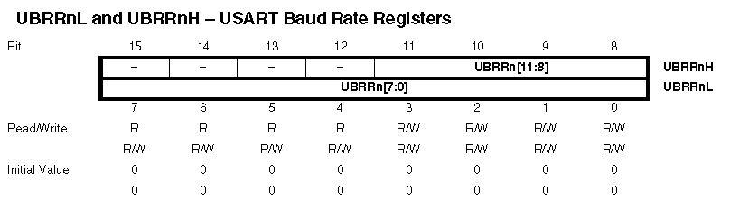
UBBR Baud Rate Register

Slide 24
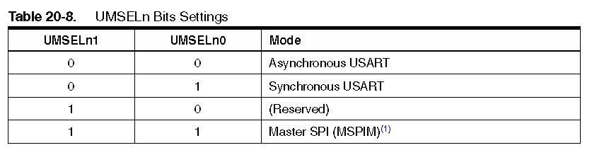
UMSELn

Slide 25
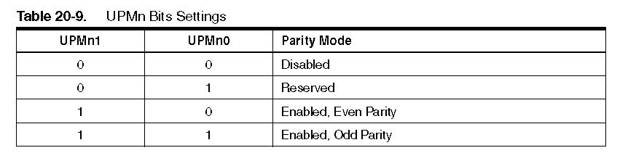
UPMn Decides Parity Mode

Slide 26
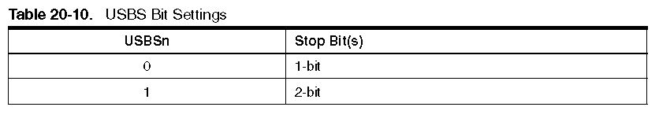
USBS : Stop Bit

Slide 27
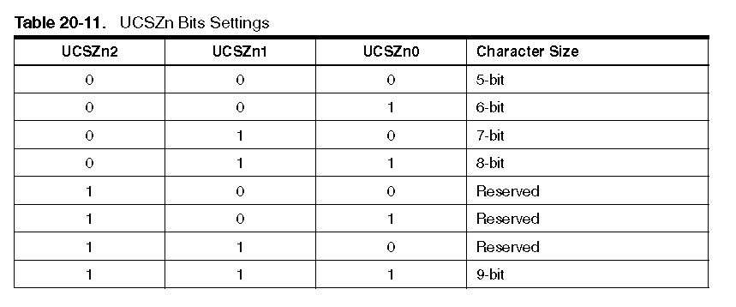
UCSZn

Slide 28
References
https://www.sqa.org.uk/e-learning/NetTechDC01BCD/page_02.htm
https://www.youtube.com/watch?v=ZzRXKDkMBhA
http://tutorial.cytron.com.my/2012/02/16/uart-universal-asynchronous-receiver-and-transmitter/

Slide 29
http://whatis.techtarget.com/definition/USART-Universal-Synchronous-Asynchronous-Receiver-Transmitter
https://www.youtube.com/watch?v=rbGxlHzK9P0
https://exploreembedded.com/wiki/UART_Programming_with_Atmega128
http://maxembedded.com/2013/09/the-usart-of-the-avr/#Reg

